Slide 1
Street Lighting System with Intensity Control based on Vehicle Movements and Atmospheric Conditions using iot
BY
G DEVANANDA

Slide 2
Relevance Of Smart Street Lighting Technology
Now a days environment norms & energy is important aspects for street lighting systems design.
Developing countries like India, where these street light monitoring & control system plays important role to reduce the specific power consumption.
It is a street light system with intensity control based on vehicle movement, weather & climatic conditions using IOT.

Slide 3
Introduction Of Smart Street Lighting Technology
It is a remote street light system with intensity control based on vehicle movement, weather & climatic conditions like humidity, cloudly weather, rainy season;
It is works on LED and wireless sensors network like zigbee.
The system is automatic controlling of street light according to seasonal variations, which includes auto loop system with respective time dependent, while vehicle crossing the road.

Slide 4
Objectives
The main objective is to make system with more safety, trouble free, maintainability, operating running cost also low & more reliable to sustain the system.
Specific Energy consumption reduced due to dimming of light when not in use.
Toxic chemical is not used in LED.
Life time of LED is higher : so only required initial cost and no need of maintenance issues like repairing, defect in system.

Slide 5
Existing System
The present system is like, the street lights will be switched on in the evening before the sun sets and they are switched off the next day morning after there is sufficient light on the roads.
But the actual timings for these street lights to be switched on are when there is absolute darkness.

Slide 6
Proposed System
This is a remote street light system with intensity control based on vehicle movement, weather & climatic conditions.
It is based on LED and wireless sensor network like zigbee.
The system is automatic controlling of street light according to seasonal variations, which includes auto loop system with respective time dependent, while vehicle crossing the road.
It can also be controlled by bluetooth connectivity.
It will give large impact on saving electricity.

Slide 7
System Methodology
In Modern street lighting system, initially in night Time all the street lights are activated on in dim condition.
Now initialize the entire sensor, when the LDR = high(i.e.,above 60%) and PIR=1 then LED and Torch glow in full brightness, thus condition as it in night.
When LDR senes between 60% and 30% then LED on in dimming condition.
Now LDR=low(i.e.,below 30%) and PIR=0 then LED and Torch is in off state, there the condition as it in day.
If the movement is not detected then it remains in dimming condition.

Slide 8
Modules
1.PIR Module
A PIR-based motion detector is used to sense movement ofpeople, animals, or other objects.
An individual PIR sensordetects changes in the amount of infrared radiation impingingupon it,
which varies depending on the temperature and surface
characteristics of the objects in front of the sensor.

Slide 9
Modules
2.LDR Module
LDR uses the light dependent change of resistance according to
intensity of light. Two resistance are connected in parallel one
is standard resistance and the other is LDR.

Slide 10
Modules
3.Intensity Control
Initially, the process is started.
Then read the PIR value and LDR value.
If the PIR value is equal to one and LDR is HIGH then the light glow bright.
If the PIR value is one and LDR value is LOW then the light glow dim.
If the PIR value is zero and LDR is zero then light will turn off.
The process continues.

Slide 11
Modules
4. Users
Public
Admin
Engineers

Slide 12
Hardware used
Micro controller
Power supply
LDR (Light Dependent Resistor)
LED and Torch(for showing bright state and dim state respectively)
PIR (Passive Infrared Sensor)
Bluetooth connectivity

Slide 13
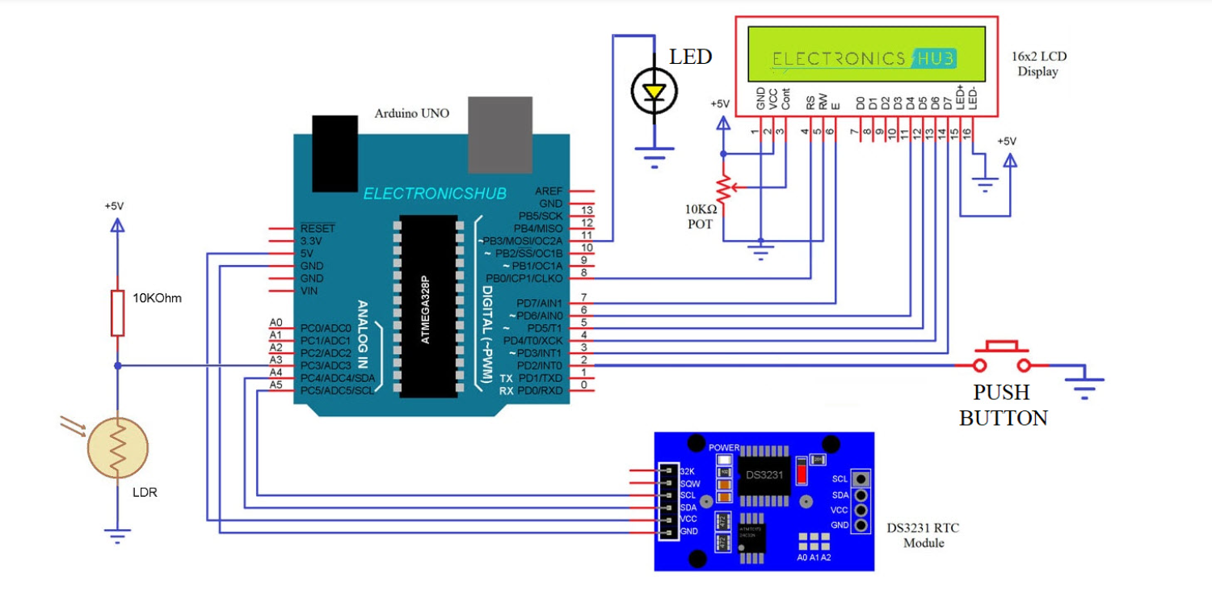
Circuit Diagram

Slide 14
Circuit Design
A Resistor and an LDR are connected in a voltage divider format and its output is given to A3 pin (of Arduino).
The data pins of 16×2 LCD Module i.e. D4 – D7 are connected to Arduino.
The RS and E pins are connected.
An LED is connected to Arduino.

Slide 15
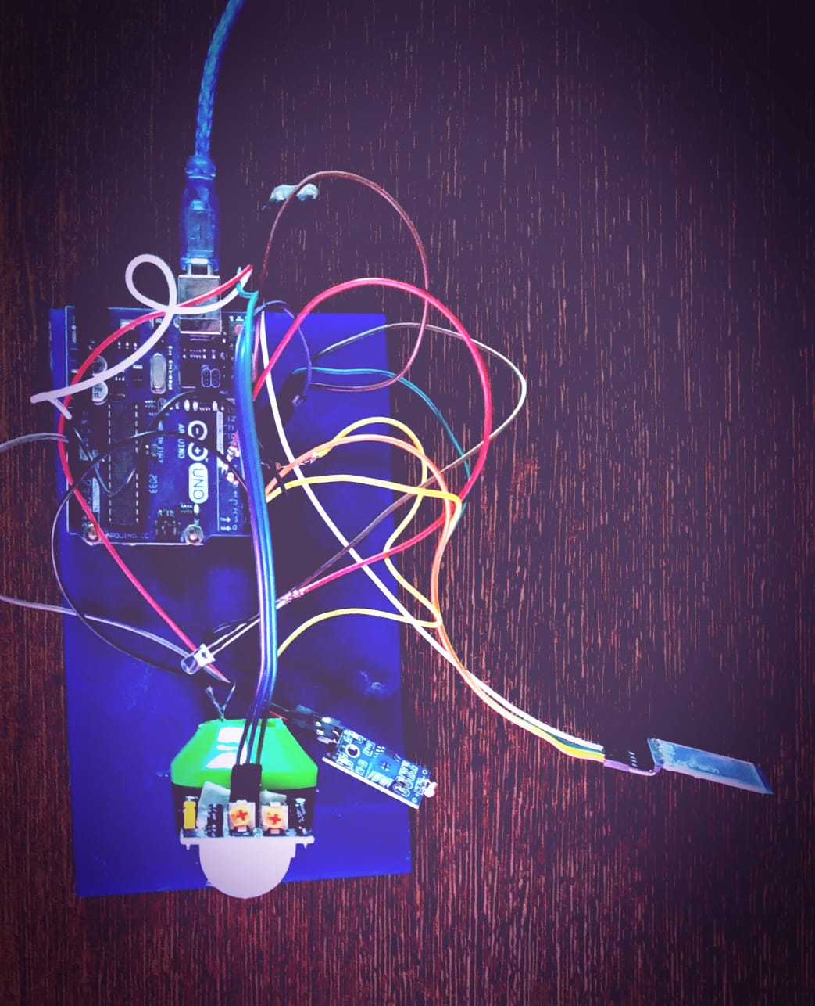
Design
Bluetooth
Sensor
LED
LDR Sensor
PIR Sensor
Arduino UNO
Board
USB
Cable
Torch light for
dim light

Slide 16
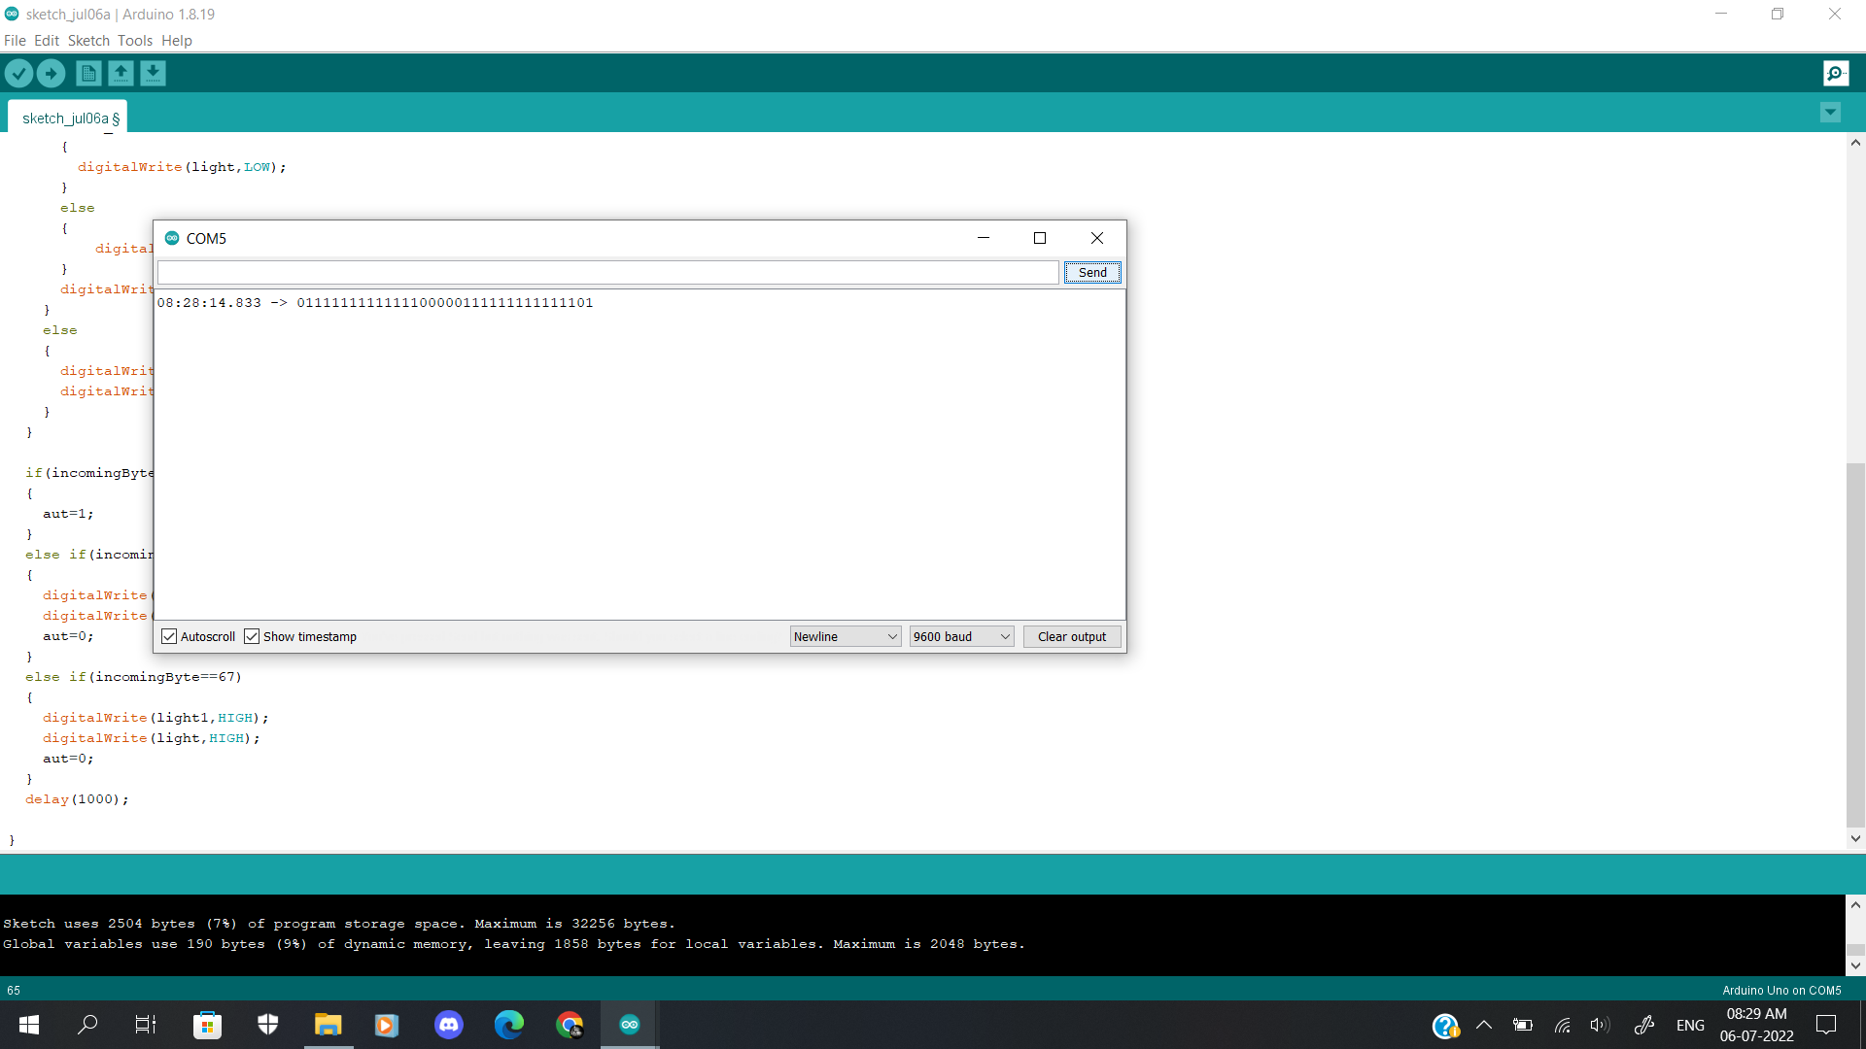
RUN TIME - TIMESTAMP

Slide 17
Thank You!!

